Slide 1
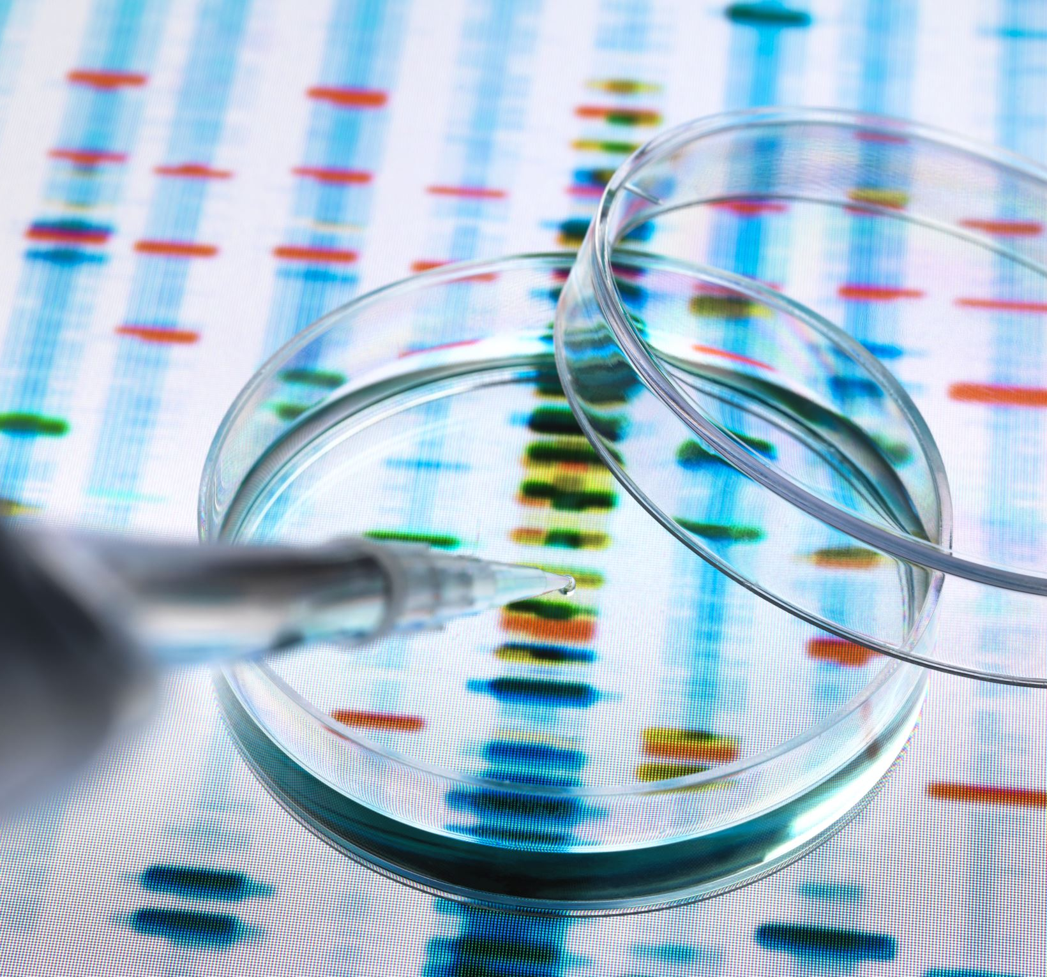
PROTEIN ASSAY
Cell Biology LAB

Slide 2
You Tube link
https://youtu.be/63MnFPHhH_w

Slide 3
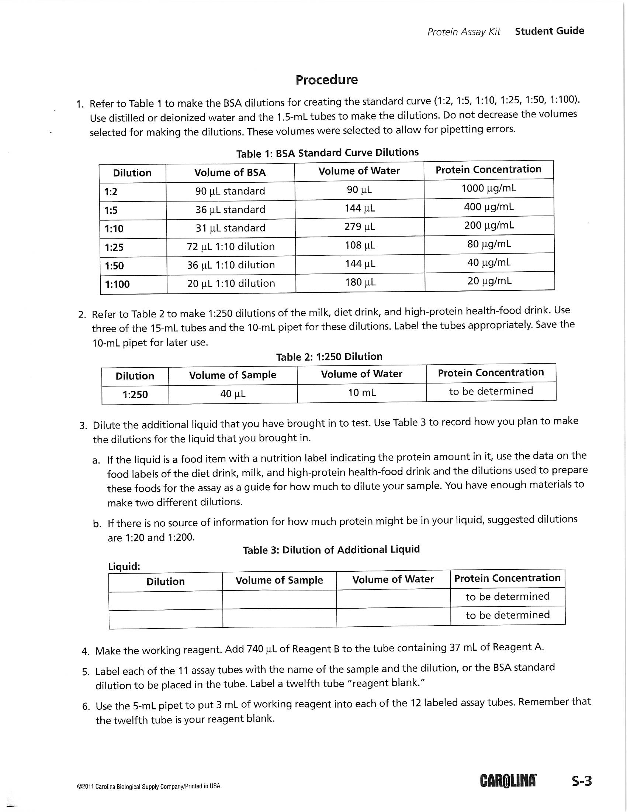
Experimental procedures

Slide 4
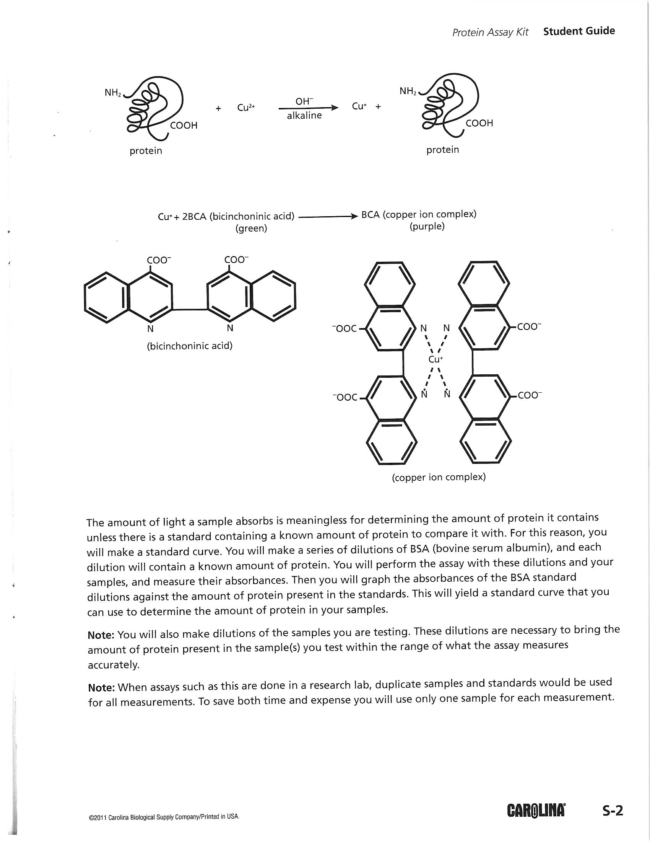

Slide 5
Protein Standard
Table 1 Spectrophotometric Readings of Protein Concentrations
Standard | Protein Concentration | Absorbance at 562 nm
BSA | 1000 μg/mL | 1.870
BSA | 400 μg/mL | 0.903
BSA | 200 μg/mL | 0.488
BSA | 80 μg/mL | 0.321
BSA | 40 μg/mL | 0.257
BSA | 20 μg/mL | 0.226

Slide 6
Unknown Protein
Sample | Abs. (562)
Milk | 1.062
High Protein health Drink | 1.095
Diet Drink | 2.68
https://youtu.be/qi4QBmFNGW4

